Slide 1
Big Data – Amazon Web Services Week 9
Professor Arturo Castellanos, PhD
Assistant Professor – William & Mary
Big Data - MSBA

Slide 2
Welcome back!

Slide 3
Big Data Review
5 V’s: Volume (size); Variety (formats); Velocity (Speed of data)
Batch processing:
Breaking the job into smaller pieces and run these pieces on different machines (e.g., Map Reduce)
Stream processing:
Processing the data in real-time (e.g., Apache NiFi)
Next, Spark!

Slide 4
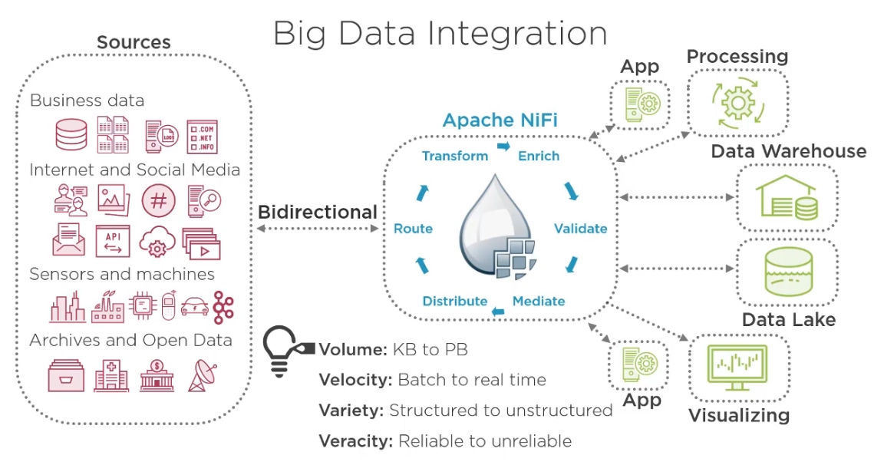

Source: Pluralsight
NiFi lab: Deadline Friday 3/25 (Midnight)
Troubleshooting – You can see the flow of the data, operator by operator look at the input/output, is this the expected behavior?

Slide 5
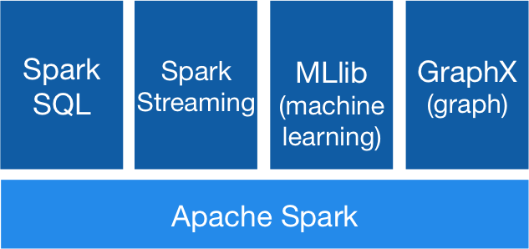
Big Data Processing: Spark
General purpose (in-memory) distributed cluster computing.
Open source
Both for batch and real-time processing
Spark has a local mode: single machine for testing
Chapter 7 - © 2019 Arshdeep Bahga & Vijay Madisetti

Slide 6
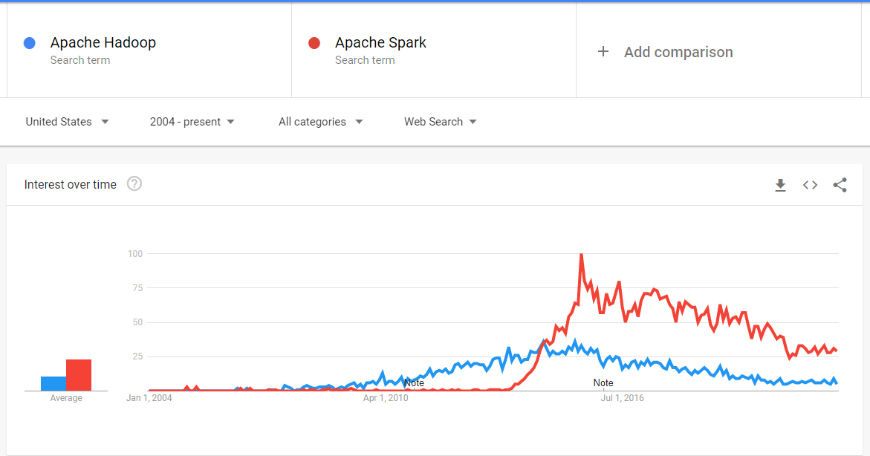

Slide 7
Spark Components
Spark SQL is a Spark module for structured data processing. It provides a programming abstraction called DataFrame and can also act as distributed SQL query engine.
Spark Streaming enables powerful interactive and analytical applications across both streaming and historical data
MLlib is a scalable machine learning library that provides a uniform set of high-level APIs that help users create and tune practical machine learning pipelines.
Spark Core is the underlying general execution engine for the Spark platform. It provides an RDD (Resilient Distributed Dataset) and in-memory computing capabilities.
Chapter 7 - © 2019 Arshdeep Bahga & Vijay Madisetti

Slide 8
Spark Core
Spark Core provides common functionality (such as task scheduling and input/output), which used by other spark components.
Data abstraction Spark provides data abstraction called resilient distributed dataset (RDD) which is a collection of elements partitioned across the nodes of the cluster
Parallelization the RDD elements can be operated in parallel in the cluster
Immutability RDDs are immutable and distributed collection of objects
Chapter 7 - © 2019 Arshdeep Bahga & Vijay Madisetti

Slide 9
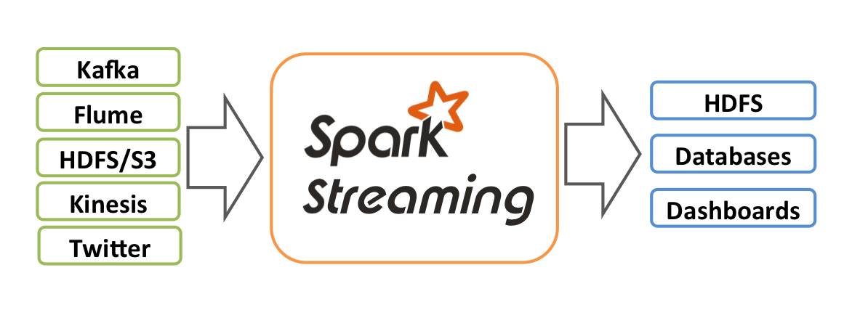
Spark Streaming
Spark Streaming is an extension of the core Spark API that enables scalable, high-throughput, fault-tolerant stream processing of live data streams (e.g., sensor data, click stream data, web server logs, etc.). Processed data can be pushed out to filesystems, databases, and live dashboards.
Source: https://spark.apache.org/docs/latest/streaming-programming-guide.html
Chapter 7 - © 2019 Arshdeep Bahga & Vijay Madisetti

Slide 10
Spark SQL
Spark SQL is a Spark component that enables interactive querying of data using SQL queries
When running SQL from within another programming language the results will be returned as a Dataset/DataFrame.
Unlike the basic Spark RDD API, the interfaces provided by Spark SQL provide Spark with more information about the structure of both the data and the computation being performed.
Chapter 7 - © 2019 Arshdeep Bahga & Vijay Madisetti

Slide 11
Spark MLib
Spark MLib is Spark’s machine learning library that provides implementations of commonly used machine learning algorithms for clustering, classification, regression, collaborative filtering, and dimensionality reduction.
Spark GraphX
Spark GraphX is a component for performing graph computations. GraphX provides implementations of common graph algorithms such as PageRank, connected components, triangle counting.
Chapter 7 - © 2019 Arshdeep Bahga & Vijay Madisetti

Slide 12
PySpark
Apache Spark is written in Scala. PySpark is an interface for Apache Spark in Python.
It allows you to write Spark applications using Python APIs
Provides the PySpark shell for interactively analyzing your data in a distributed environment
PySpark supports most of Spark’s features such as Spark SQL, DataFrame, Streaming, MLlib (Machine Learning) and Spark Core
Chapter 7 - © 2019 Arshdeep Bahga & Vijay Madisetti

Slide 13

Components of a Spark Cluster
Each Spark application consists of a driver program and is coordinated by a SparkContext object.
Spark supports various cluster managers including Spark’s standalone cluster manager, Apache Mesos, and Hadoop. The cluster manager allocates resources for applications on the worker nodes.
The executors which are allocated on the worker nodes run the application code as multiple tasks.
When you launch a PySpark shell, a SparkContext is created with the variable name sc.
Chapter 7 - © 2019 Arshdeep Bahga & Vijay Madisetti

Slide 14
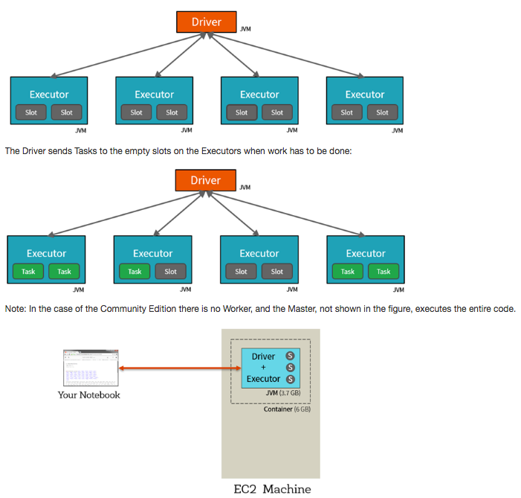
Spark Physical Cluster
At a high level, every Apache Spark application consists of a driver program that launches various parallel operations on executor Java Virtual Machines (JVMs) running either in a cluster or locally on the same machine.

Slide 15
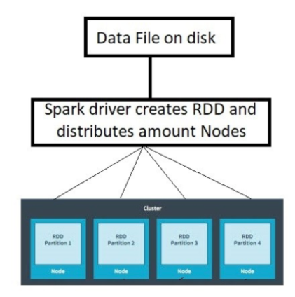
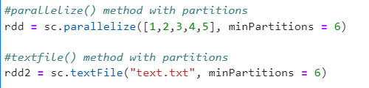
Resilient Distributed Datasets (RDDs)
Resilient: Ability to withstand failures
Distributed: across multiple machines
Datasets: collections of partitioned data (e.g., arrays, tables, tuples)
A partition in spark is a logical division of a large distributed dataset. The number of partitions in an RDD can be found by using getNumParititons()
Chapter 7 - © 2019 Arshdeep Bahga & Vijay Madisetti

Slide 16
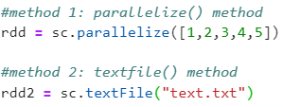

Resilient Distributed Datasets (RDDs)
A collection of data distributed across the cluster.
Data type for PySpark
RDDs can be created either by parallelizing existing collections or by loading an external dataset:
Spark Operations:
Transformations: create a new RDD from an existing RDD.
Actions: return a value to the driver program after running a computation on the dataset
Chapter 7 - © 2019 Arshdeep Bahga & Vijay Madisetti

Slide 17
Group Project
The goal of the project is to apply the concepts learned in class and develop a solution that involves, collecting, storing, and analyzing Big Data (3 V’s: Volume, Variety, Veracity)
Phase I – 10 points (Deadline 4/4) [Word document]
Phase II – 15 points (Deadline 4/18) [Word document + Jupyter Notebook and related files) + Peer evaluation.
Presentations
Day 1 4/18 (5 Teams)
Day 2 4/20 (5 Teams)

Slide 18
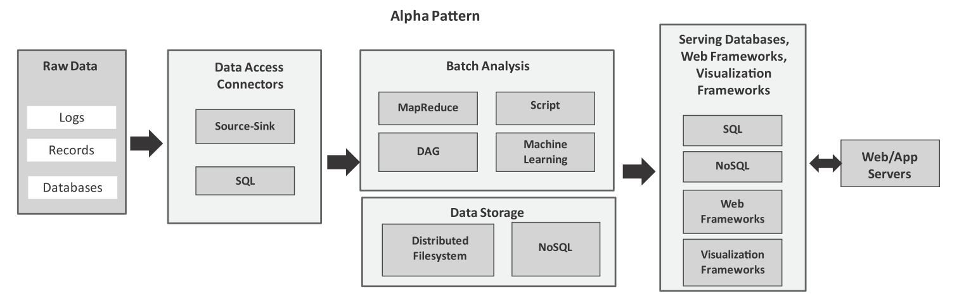
Analytics Patterns: alpha pattern
Alpha pattern
This pattern can be used for ingesting large volumes of data into a distributed ﬁlesystem (such as HDFS) or a NoSQL database (such as HBase) using source-sink connectors (such as Flume) and SQL connectors (such as Sqoop). After the data is moved to the stack, the data can be analyzed in batch mode with batch analysis frameworks including MapReduce (using Hadoop), scripting frameworks (such as Pig), distributed acyclic graph frameworks (such as Spark), machine learning frameworks (such as Spark MLlib). The analysis results are stored either in relational or non-relational databases.
Chapter 8 - © 2019 Arshdeep Bahga & Vijay Madisetti

Slide 19
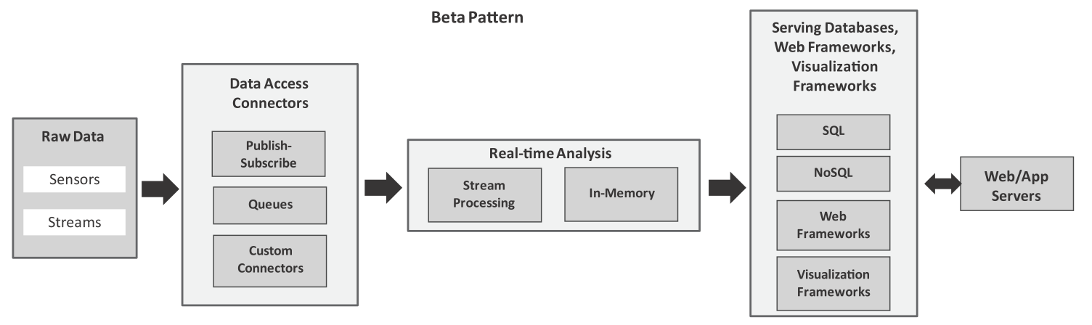
Analytics Patterns: beta pattern
Beta pattern
This pattern can be used for ingesting streaming data using publish-subscribe messaging frameworks, queues and custom connectors. For real-time analysis, we can use stream processing frameworks (such as Storm) or in-memory processing frameworks (such as Spark).
Chapter 8 - © 2019 Arshdeep Bahga & Vijay Madisetti

Slide 20
Install Spark in Anaconda Terminal
We will create a new environment in Anaconda and Install the necessary libraries.
Open Anaconda Prompt (shell) in Admin mode.
Run the following commands (one at a time). If conda does not work, replace with pip:
conda create --name pyspark conda activate pyspark conda install python conda install pypandoc conda install pyspark conda install jupyterlab conda install pandas conda install matplotlib pip install pyspark-dist-explore
Once you ran these commands successfully, enter:
jupyter lab
Upload the Spark Notebook to your Jupyter lab

